Slide 1
Insights taken from timestamp data of TM
Presented by Jan Carlo L. Lima

Slide 2
Insight #1: User types
Users have log-in patterns
How many times have they logged-in the past year?
How many projects in which they are involved?
From these patterns we can deduce their positions and responsibilities
Project bosses/Company bosses (founding/early employee, lots of projects)
Regulars (recently employed, limited projects)
Interns/Temporary (employed only for a while, few projects)

Slide 3
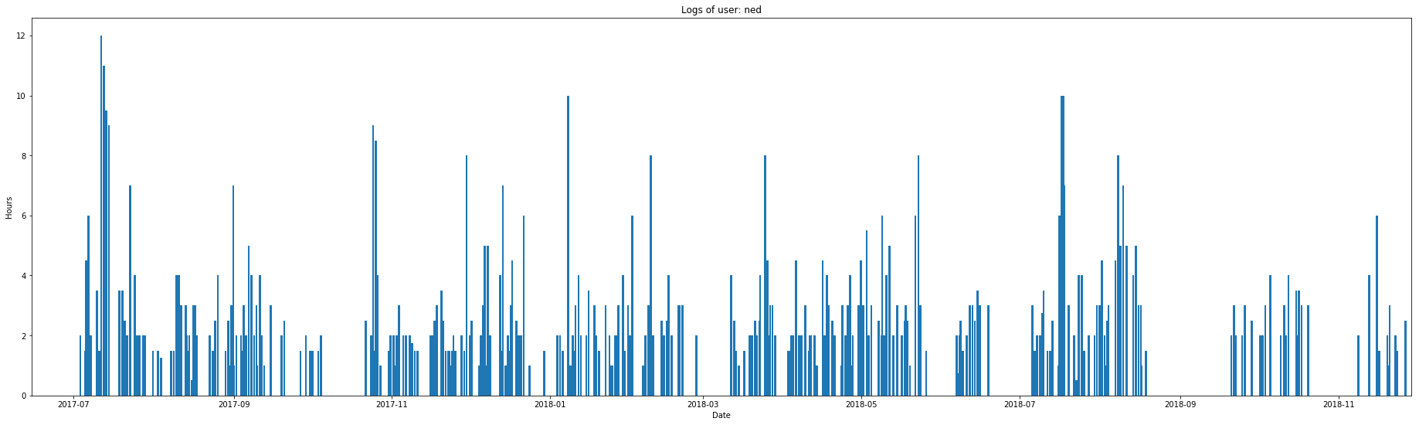
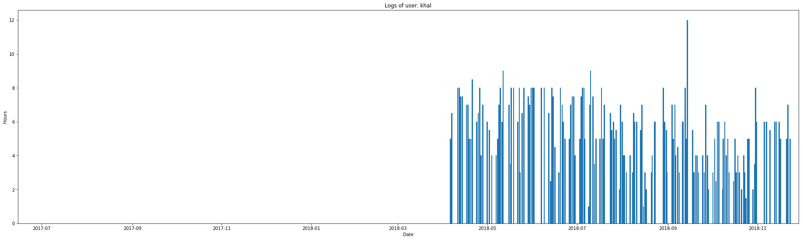
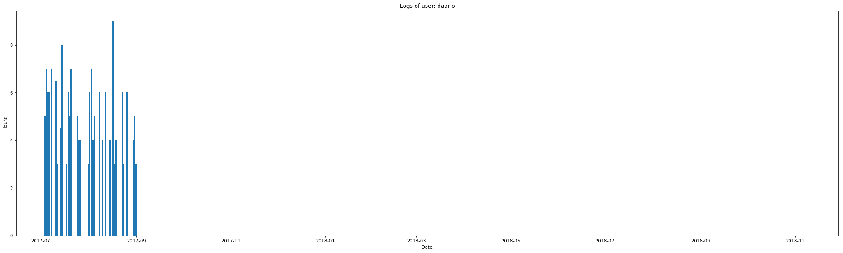
Boss
More than 30 total projects
greater than or equal to 1000 hours logged
ex. ‘ned’
Regular
10-20 total projects
more than 500 hours logged
ex. ‘khal’
Temporary
15 or less total projects
less than 500 hours logged
ex. ‘daario’

Slide 4
Bosses
Employees
Interns/Temps
‘ned’
‘davos’
‘bronn’
’jorah’
‘littlefinger’
Regulars
‘robert’
‘margaery’
‘shae’
‘samwell’
‘theon’
‘jaime’
‘tyrion’ – was on leave
Resigned or Fired
‘gendry’
‘tywin’
New
‘catelyn’ – high position
‘sansa’ – high position
‘joffrey’ – high position
‘varys’
‘jeor’
‘melisandre’
‘stannis’
‘khal’
‘hound’
‘bran’
‘robb’
‘arya’
‘jon’
‘viserys’
’daenerys’
‘tommen’
‘ellaria’
‘daario’
‘missandei’
‘talisa’
‘ygritte’
‘tormund’
‘bran’
‘gilly’
‘ramsay’
‘brienne’
Above is the deduced company structure. These are all based on the logs:
Bosses have a lot of hours logged and projects to look after
New - logged later, but have the minimum projects for a regular
‘high position’ means they are new, but have enough or more projects than a regular
Resigned or fired– since they have projects and hours that of a regular but stopped logging before the year ended
‘tyrion’ went on leave during October 2017 but returned in August 2018

Slide 5
Insight #2: Project types
Projects also have log-in patterns
How many hours have been logged in them the past year?
How many users are involved?
From these patterns we can deduce their importance
Main projects – important ones, therefore requiring more of the company’s time and resources
Side projects – could be partnership with another company or just a smaller project
Either: Ad hoc or Internship or Starting, Projects – projects made when necessary, given to interns

Slide 6
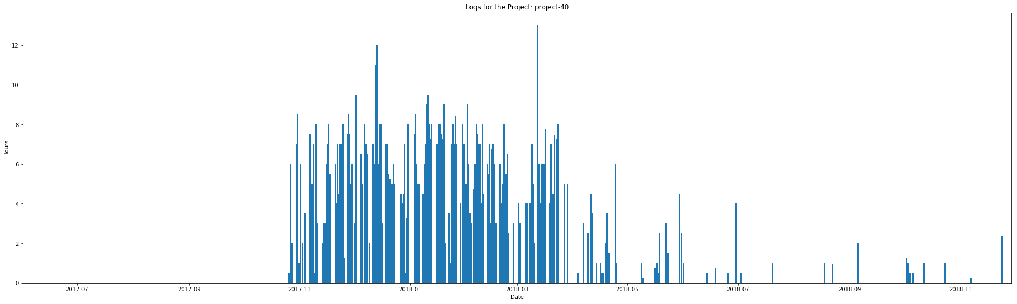
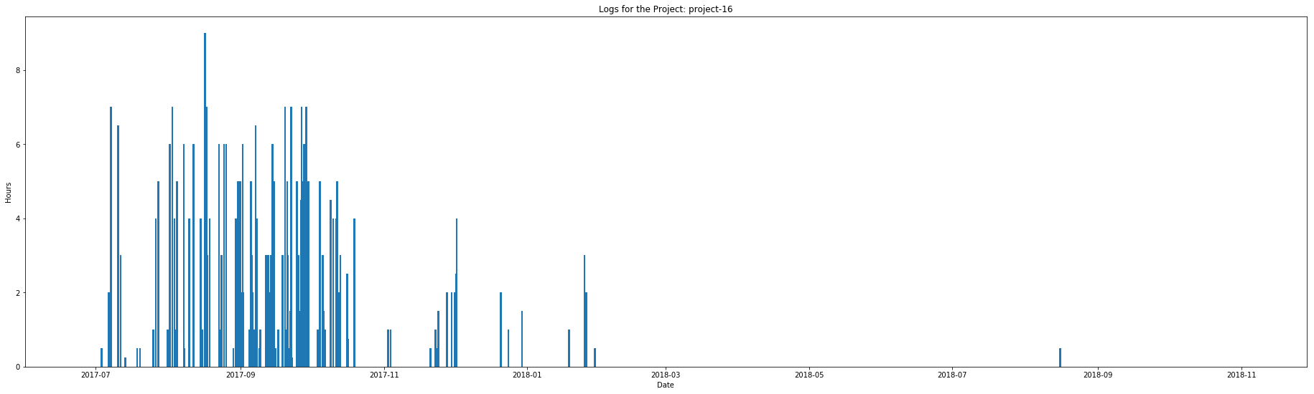
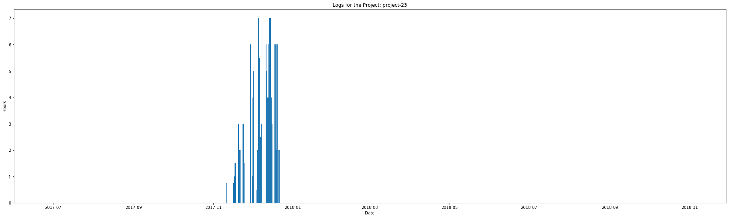
Main Project
More than 1000 total hours
15 or more user have logged
ex. ‘project-40’
Side Project
500-1000 total hours
10 users have logged
ex. ‘project-16’
Ad Hoc Project
500 total hours or less
around 5 users have logged
ex. ‘project-23’

Slide 7
Main Project
Side Project
Ad Hoc Project
culture-and-management
external-affairs
finance-and-marketing
internal-affairs
machine-learning
Projects:
00
10
20
40
datascience
events
recruitment
Projects:
06
13
30
43
55
64
65
68
73
engineering
interns
misc (miscellaneous)
security
Projects:
the rest from 01-74 (excluding main and side projects)
Above is the deduced company structure. These are all based on the logs:
Main projects have a lot of hours logged and a lot of users logging-in in them
Side projects
Ad hoc projects may be new ones
all admin projects (the ones with no ‘project-##’) are company-intrinsic duties
which also have varying number of log-in hours and users

Slide 8
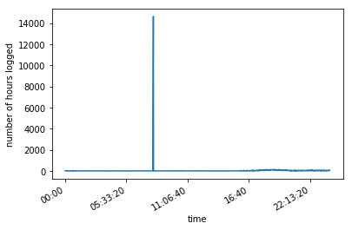
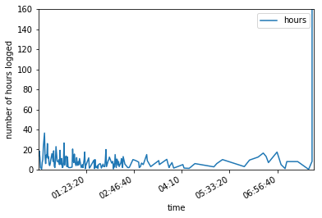
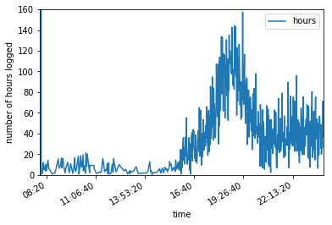
INSIGHT #3: user shifts
An outlier! This particular time (8:00am) has 14621.40 hours of log. That means this is usually the time when people come in the office.
Removing the outlier value, we see that employees log in the morning, and work on their respective projects until nighttime.

Slide 9
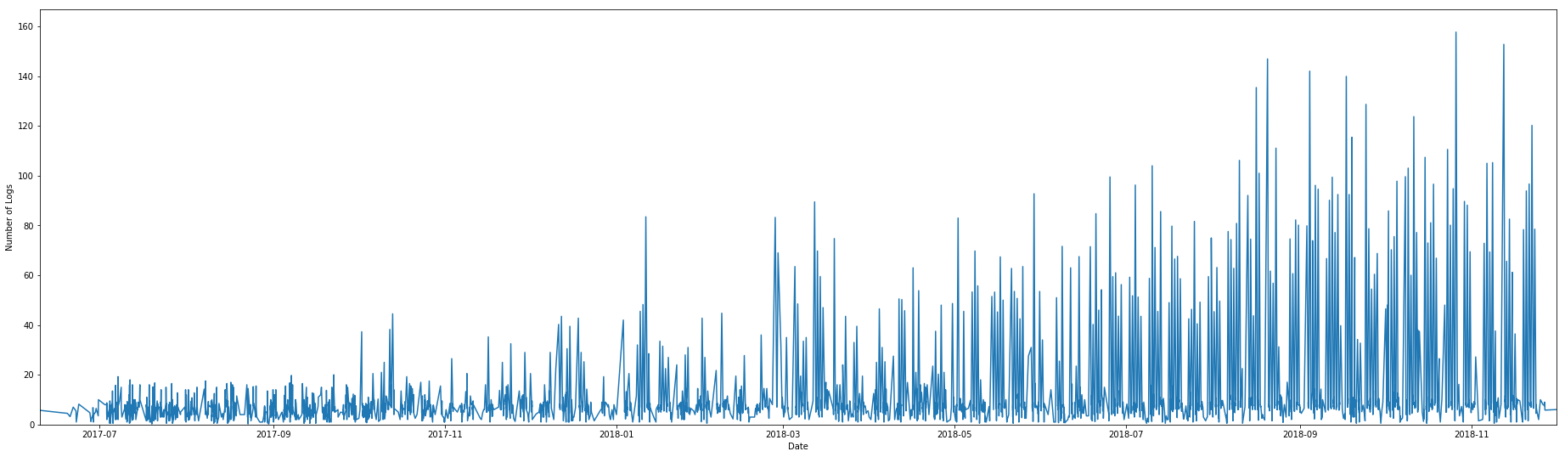
INSIGHT #4: Company growth
From the plot above, we see that there are more hours of work later in the year. This could mean the following:
The company has been hiring more people recently
The employees have been working more hours
New projects are being made, thus asking more hours for the employees
Of course, whichever one is true, we are sure that the company is doing great.

Slide 10
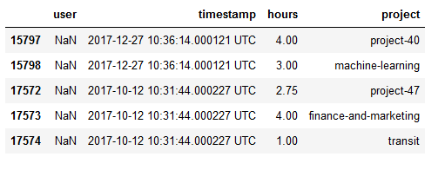
INSIGHT #5: Missing User logs
From the data given, some user logs were found to be NaN, or null.
With cross-referencing and some deduction we have a shortlist for whom the NaN user might be.
These are at most two people since the logs are at the same time at two different instances.

Slide 11
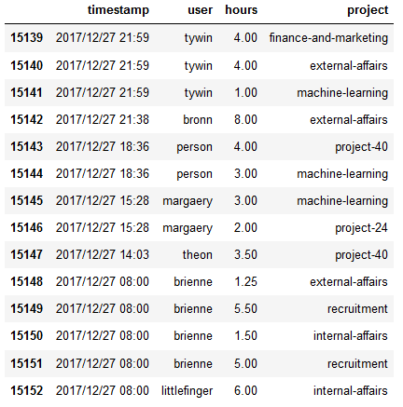
INSIGHT #5: Missing User logs
These are all the people logged at Dec. 27, 2017.
It cannot be ‘catelyn’, ‘cersei’, since they first logged at 2018.
Best guess would be either ‘margaery’ or ‘theon’ since they are the recent ones that dealt with ‘project-40’ and ‘machine-learning’.

Slide 12
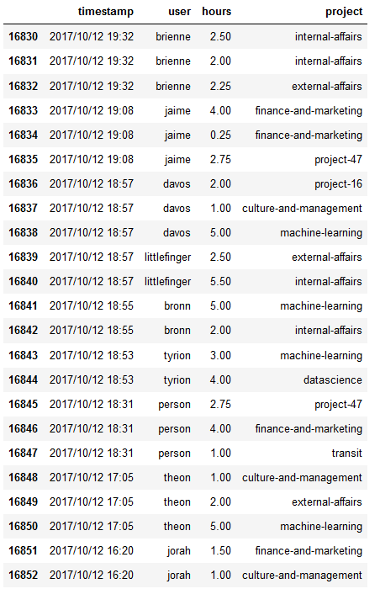
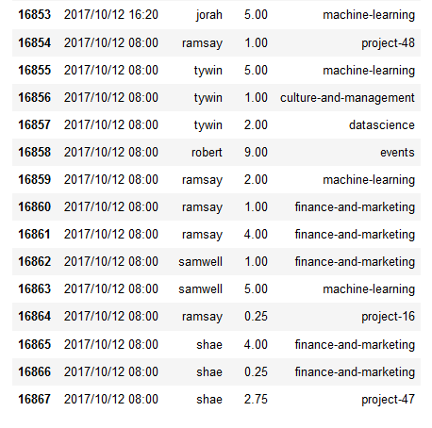
INSIGHT #5: Missing User logs
These are all the people logged at Oct. 12, 2017.
Best guess would be ‘jaime’ or ‘shae’ since they recently handled ‘project-47’ and ‘finance-and-marketing’. ‘Transit’ could mean they are transferring from one building to another.

